Slide 1
FDA Alert: Food
Initial User Research Findings
6/29/15

Slide 2
Agenda
Research Overview
Key Findings
Recommendations

Slide 3
Research Overview

Slide 4
Goals & Objectives
01
To determine how consumer learn about food recalls that impact them
03
To learn more about what information is most important to people searching for food recall information
02
To understand how users would prefer to search for information about food recalls
04
To gather common scenarios from consumers who have been impacted by a food recall

Slide 5
Research Methodology
On June 26th, 27th and 28th a survey was conducted with 12 respondents.
Respondents represented the target audience for FDA Alert: Food:
Consumers impacted by a food recall
Consumers concerned about food recalls in their area
The survey was launch via social media and email using Survey Monkey.
A researcher reviewed all results and individual feedback from survey respondents.

Slide 6
Findings

Slide 7
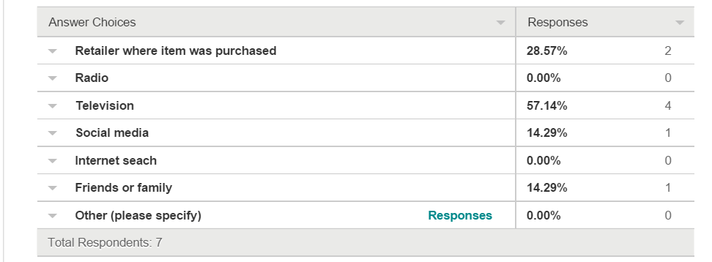
Findings
The majority of respondents who have been affected by food product recalls got the information about food recalls from television.

Slide 8
Findings
Respondents impacted by a food recall rated the product name as highest priority information, followed by the reason for the recall. This priority was also validated by respondents who had not been impacted by a food recall when asked what information would be most important in internet search results.
Information ranked in order of importance:
Product name
Reason for recall
Severity of health risk
Product identifier for food impacted by recall i.e. lot number, sell-by-date
Date the recall began
Whether the recall was voluntary or mandated by the FDA

Slide 9
Findings
Once respondents are aware of a food recall, they would primarily use the internet to get more information.
92% of respondents would search for additional information on the internet
33% of respondents would watch television to learn more
17% of respondents would ask friends or family for more information
When searching, most respondents indicated they would search by product name.
92% of respondents would search by product name
17% of respondents would search by manufacturer
17% of respondents would search by food type
One respondent would like to search by scanning the bar code
Once respondents are aware of a food recall, 92% of respondents would also like information about what to do with the food that was recalled and whether they would be eligible for a refund.

Slide 10
When consumers are impacted by food recalls
Traditional channels of communication sometimes work for food recalls. Other times, consumers are not aware of a food recall until they get sick.
“It was peanut butter and I heard about it on the radio. It was my lot number.”
“We just ate the recalled blue bell ice cream and got sick from it before we realized it was recalled”
“I only purchased the product once. It was later, after I didn't have it in my home any more, that it was recalled.

Slide 11
Recommendations

Slide 12
Summary of Recommendations
Create a tool that allows consumers to search for food recalls in their area. Consider an alert system that would allow users to sign up to be contacted when there is a recall in their area to prevent unexpected illness.
Site should leverage users location to proactively inform them of recalls in their area
Information should be precise and contain information that makes it easy for the user to understand if the product impacted is something they have purchase or consumed
In addition to information about the product recall, the tool should help users navigate what to do next

